Slide 1
General Plan Community Advisory Committee Meeting 4
July 9, 2019

Slide 2
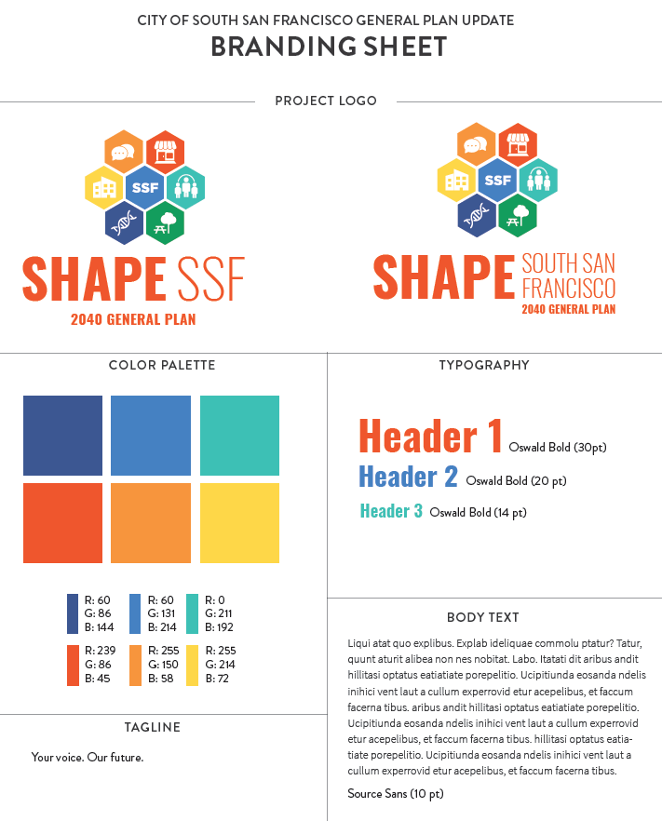
Project Branding

Slide 3
Meeting Topics
Overview of Demographic + Socio-Economic Trends
Stakeholder Meeting Update
Overview of Sub-Area (Neighborhood) Meetings
Upcoming CAC Schedule

Slide 4
Overview of Demographic + Socio-Economic Trends
Notes:
Talking points: Intro
Providing an overview of the demographic and socio-economic characteristics of the City with comparisons to previous years and the County or State to show changes over time and how the City is similar to or different than other jurisdictions.
The big take-away messages are:
The city is continuing to grow
The population is aging with more residents over 60 years old and few residents under 18
There have been significant shifts in the race/ethnicity as the City has transitioned from
As a result there has been an increase in residents born in other countries and people speaking another language at home
The City has become more highly educated over time and average HH incomes have increased however there are significant disparities between the incomes of different racial and ethnic groups
The average HH size is increasing
From a transportation perspective most people who live in the City work elsewhere and most people who work in the city live elsewhere

Slide 5
Population Trends
67,120
people in 2017
+24%
increase since 1990
(12,808 people)
9%
of the county population
+2,133
Housing units since 1990
Notes:
In 2017, the most recent year for which data is available, there were 67,120 people in the City representing 9% of the total population. The total area of the City is XXXX square miles/acres.
Population density?
Incorporated in 1908 (under 2,000 people living in the City.
Major boom in growth began in 1940 and continued until 1960. During these 2 decades the City grew from just under 7,000 people to almost 40,000 people. Since then there has been steady growth in the City and the population in 2017 was just over 67,000 people, which is an increase of 25% since 1990 (with just over 12k people). During this time the number of housing units increased by just over 2100.

Slide 6
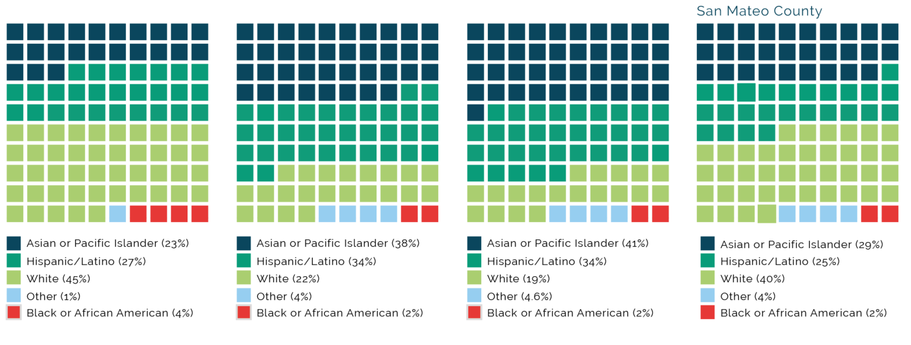
Race / Ethnicity
1990
2010
2017
Notes:
Since 1990 there have been some significant changes in the race/ethnicity of the population of SSF
Huge flip from majority white to majority API.

Slide 7
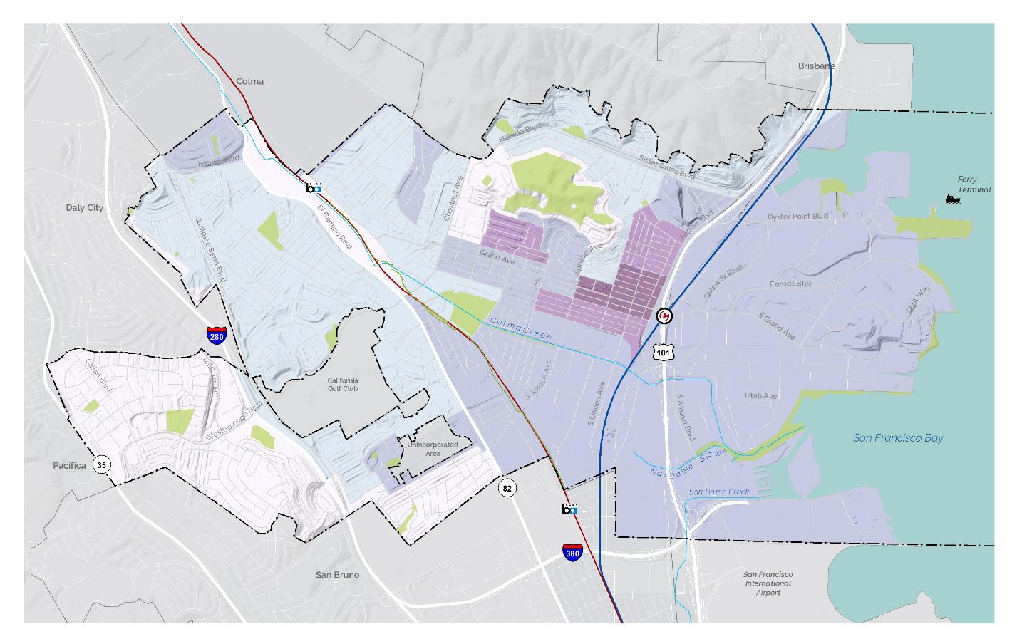
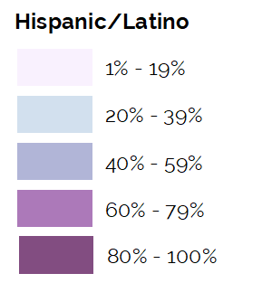
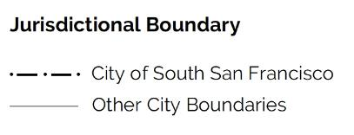
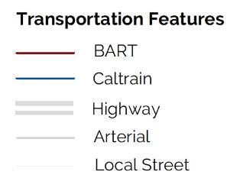
Latino Population

Slide 8
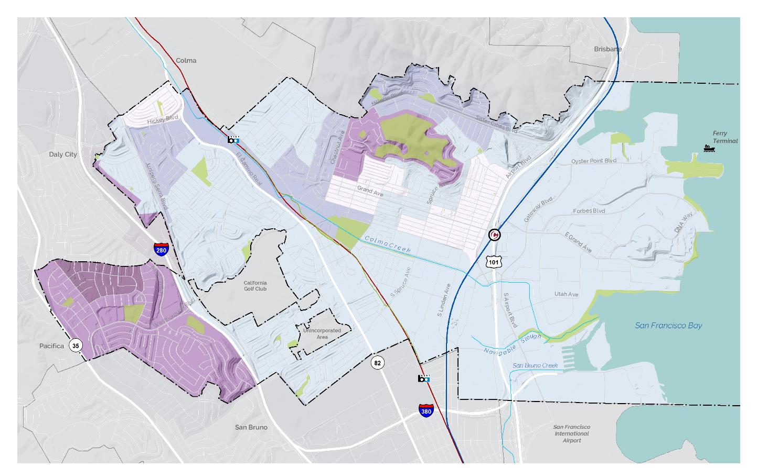
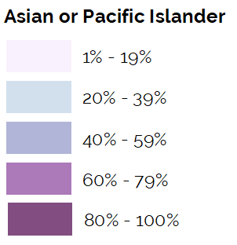
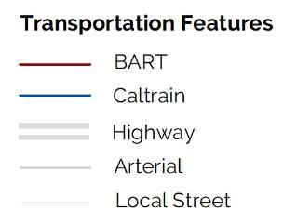
Asian or Pacific Islander Population

Slide 9
Youth and Senior Trends
YOUTH
OLDER ADULTS
+1%
+69%
Notes:
Since 2000 the population has had a slight decrease in the number of youth and an increase in the number of older adults (60+) so overall its an aging population.

Slide 10
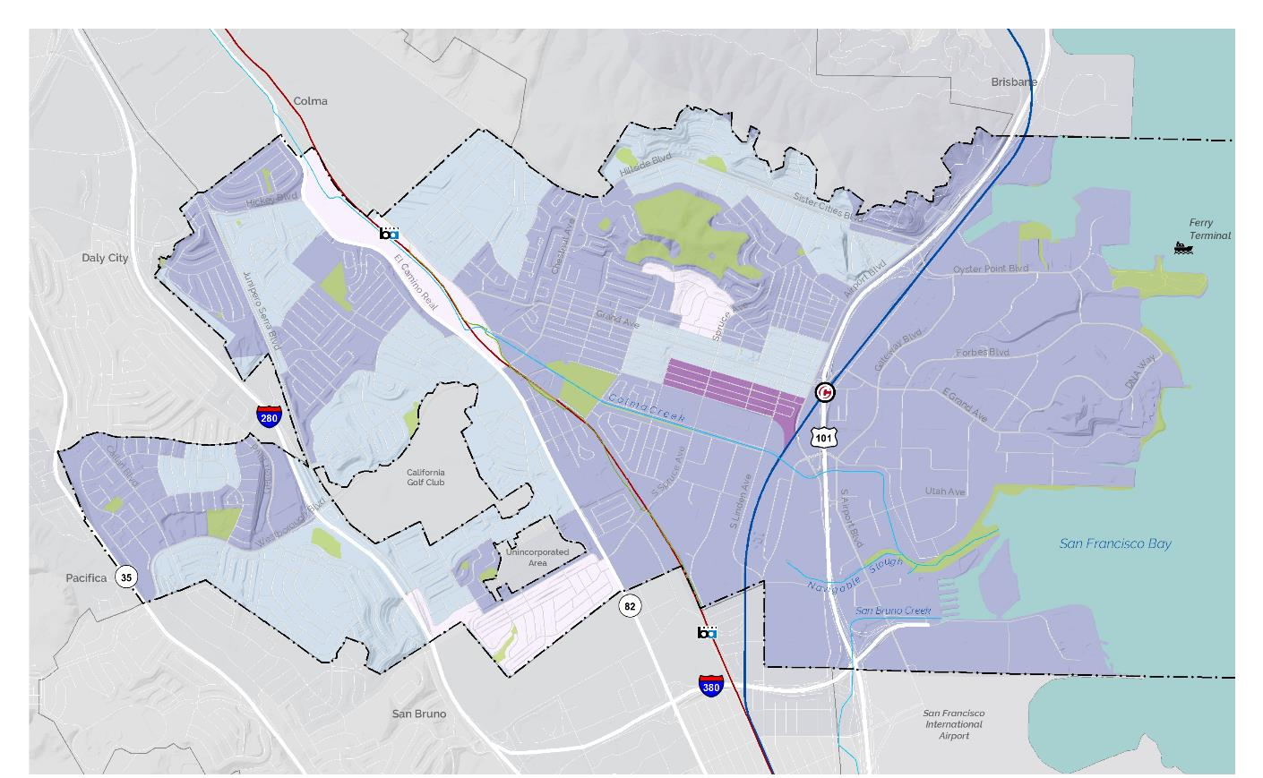
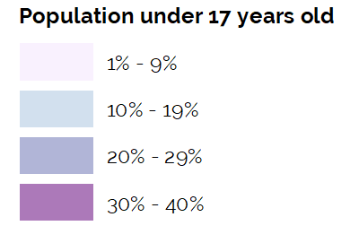
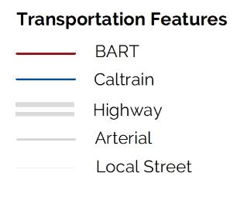
Population under 17 years old

Slide 11
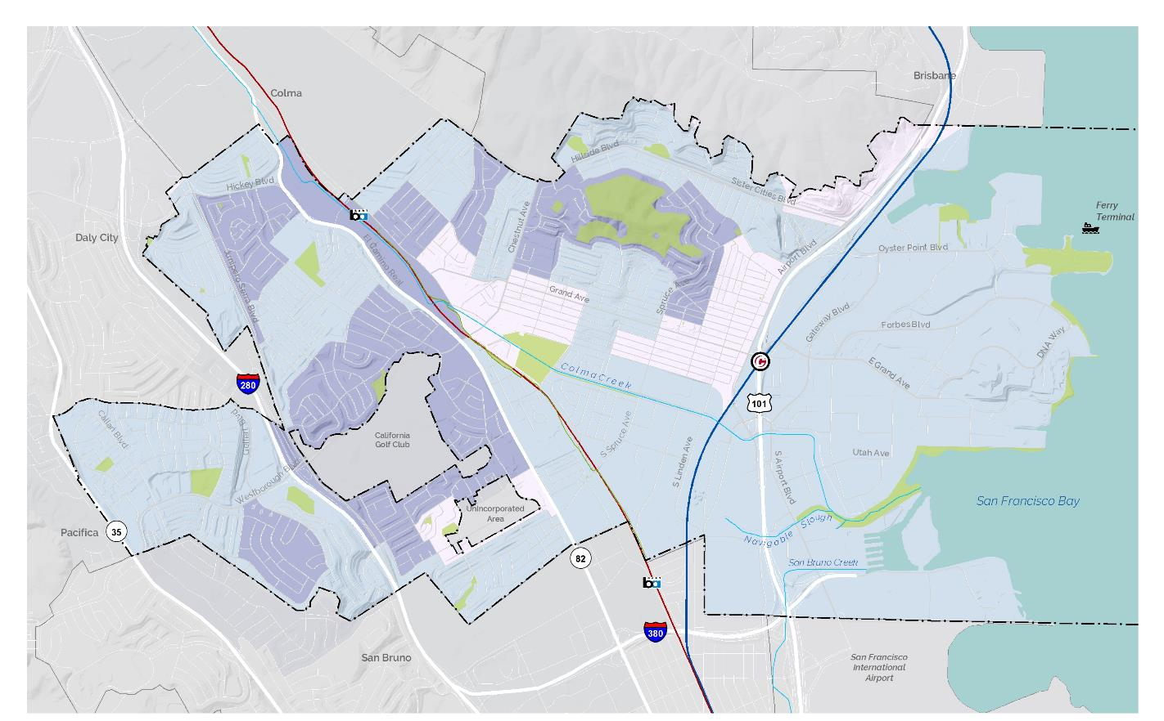
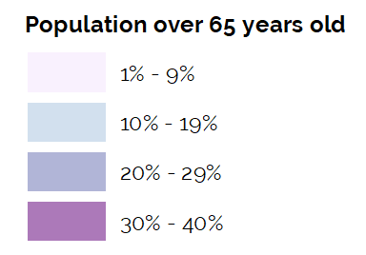
Population over 65 years old

Slide 12
Changing Household Types
Parents and In-laws Living at Home
Non-Relatives Living at Home
2.3%
2000
4.7%
2017
2.7%
2000
4.9%
2017
Increasing the people per household
to
an
2.9
people per household in 1990
3.2
people per household in 2017
+11%
increase in household size
Notes:
Since 2000 there have been some changes in the household characteristics.
The number of households with a parent or in-law has doubled from 2.3% to 4.7%.
More households have non-relative roommates (HOW IS ROOMATE DEFINED?)
The average household size has increased slightly from 2.9 to 3.2 per household.
All of this underlies some of the other trends: there are more senior adults in the City (some of whom are living with family members) and more people are sharing homes indicated by the increase in average HH size and the percentage with non-related roommates.

Slide 13
Language and Place
Languages Spoken at Home
58%
Speak a language other than English at home
25% speak Spanish
13% speak Tagalog
10% speak Mandarin or Cantonese
10% speak other languages
+10%
increase in foreign-born people living in city since 1990
63%
of children have 1+ foreign-born parent
39%
do not speak English “very well” in 2017
Notes:
What are the big points?
Large decrease in people from other states moving here since 2000. Housing has gotten expensive in the Bay Area.
A pretty stable count of English proficiency. Has only changed by less than +/-3% since 2000.

Slide 14
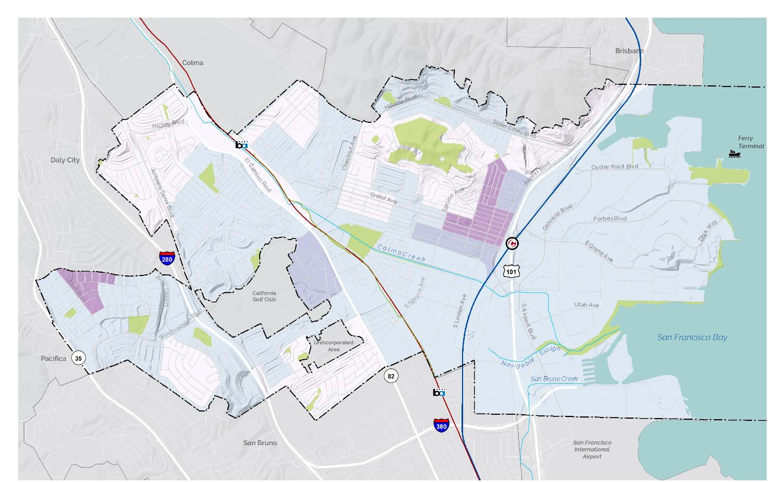
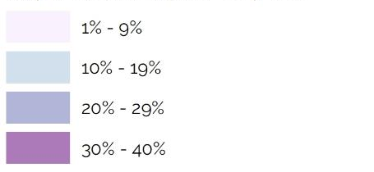
Population Who Speak English Less Than “Very Well”
Notes:
No one 14 and over speaks English only or speaks English "very well"

Slide 15
Economic Livelihood
7%
households below poverty level in 2017
+48%
increase in people over 25 with a college degree or more since 1990
Notes:
What are the big points?
The percentage of people living in poverty level is slightly higher than County (7.3%) at 7.4% lower than the statewide average of (14.6%)
Nearly 50% increase in educational attainment.
There are still disparities in the city.
$40,000 difference in median household income between Asian and Latino households below poverty level in 2014

Slide 16
Stakeholder Meeting Update

Slide 17
Stakeholder Meetings
Stakeholder Groups
Community groups
Service groups
Youth
Business
Faith-based organizations
Environmental organizations
Over 100 individuals identified; all will be invited to Stakeholder Meetings
Tentatively scheduled for July 24-26, 2019
Notes:
WILL NOTE THAT TARGETING THE END OF THE MONTH FOR THE MEETINGS
SIDE NOTE: WE SHOULD THANK CAC FOR INPUT ON THE POP-UP MEETING LOCATIONS/GROUPS AND NOTE THAT WE ARE TARGETING AUGUST FOR THOSE,

Slide 18
Stakeholder Meetings
Discussion questions:
What existing community assets or characteristics make South San Francisco special and unique?
What are the most important challenges facing South San Francisco today?
What is your vision for South San Francisco in the next 20 years?
Can you identify any new opportunities for South San Francisco that can help achieve the vision we discussed?
What would help to get community members interested in the General Plan update process, and to attend community meetings?
Notes:
WILL NOTE THAT TARGETING THE END OF THE MONTH FOR THE MEETINGS
SIDE NOTE: WE SHOULD THANK CAC FOR INPUT ON THE POP-UP MEETING LOCATIONS/GROUPS AND NOTE THAT WE ARE TARGETING AUGUST FOR THOSE,

Slide 19
Overview of Sub-Area (Neighborhood) Meetings

Slide 20
Sub-Area Meeting Objectives
Provide an overview of the SSF General Plan process and objectives
Review citywide and neighborhood conditions
Discuss what residents love, key issues, and vision for their neighborhood
Describe upcoming engagement events and ways to get involved

Slide 21
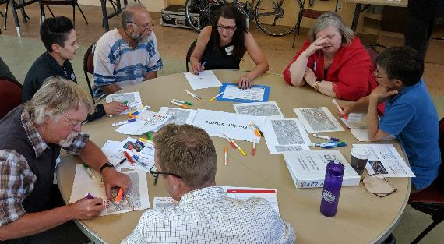
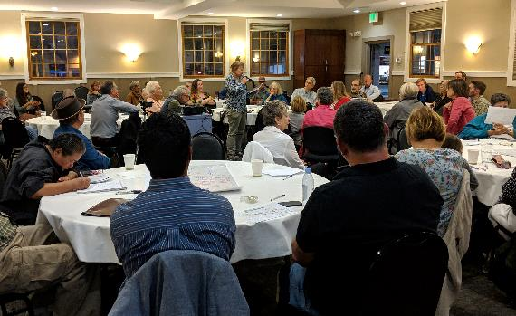
Sub-Area Meeting Format
Welcome
Overview presentation
Overview of Shape SSF and major project components
What is a General Plan and why we are updating it
Baseline Conditions
Citywide demographic and socio-economic trends
Neighborhood metrics and maps
Small group discussion
Next steps

Slide 22
Sub-Area Meetings: Draft Discussion Questions
What do you love about your neighborhood?
If you could change one thing about your neighborhood, what would it be?
What are the key issues that your neighborhood is facing now?
In the year 2040, what is your neighborhood’s tagline on the City’s website?

Slide 23
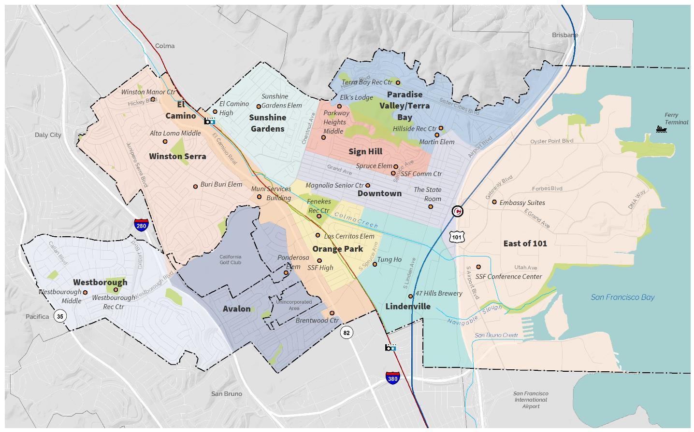
Tentative Locations for Sub-Area Meetings
Notes:
Note: Some areas may be combined
Public welcome to attend any and all of these meeting

Slide 24
CAC Input on Sub-Area Meetings
Are the questions we’re planning to ask at the meetings clear? Are there other questions we should consider?
Does the format of the meeting seem effective?
What data / information do you think would be most valuable to aid discussion?
What role (welcome, table facilitator, etc) would you like to have in the meetings? And at what meeting?

Slide 25
Upcoming CAC Schedule

Slide 26
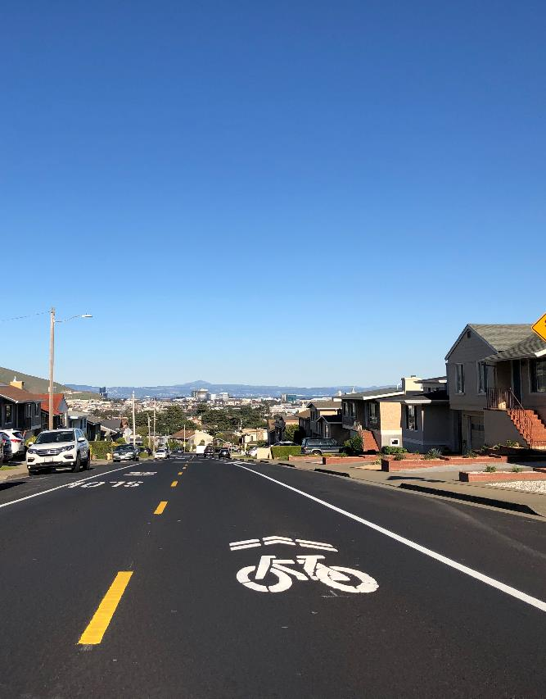
CAC Community Forum Topics: Potential Schedule
Emerging Trends in Mobility (ten. Oct 2019)
Housing Affordability + Gentrification (ten. Jan 2020)
Economic Development, Small Business + Retail (ten. March 2020)
Greenhouse Gas Reduction and Climate Change + Adaptation (ten. May 2020)
Potential future topics: Aging in Place, Public Safety

Slide 27
Topics for Future CAC Meeting Briefings
Crime Stats
Homeless Stats
Biotech East of 101 – history, where they live, what they do, number of people
Bart/Caltrain numbers to understand why people don’t use public transit
TNC’s
Age of building/housing stock and neighborhoods
Growth + Impact

Slide 28
CAC Meeting Topic Schedule – Phase 1: Visioning
Meeting #5 – September 2019
Existing Conditions Briefing - Transportation
Review Sub-Area Meeting Takeaways
Discuss CAC Forum #1 - Emerging Trends in Mobility
Preview of Community Visioning Workshop / Open House Exercises
Meeting #6 – October 2019
CAC Community Forum #1: Emerging Trends in Mobility
Meeting #7 – November 2019
Existing Conditions Briefing – Climate Change
Review Community Visioning Workshop results
Discuss Key Issues and Opportunities List
Discuss Draft Vision and Guiding Principles

Slide 29
General Plan Community Advisory Committee Meeting 4
July 9, 2019

Slide 30
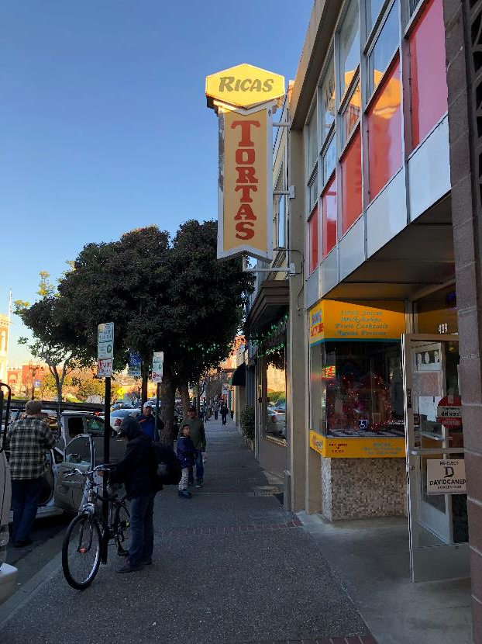
What We Heard about Potential CAC Community Forum Topics
Small Business
Survival of ground floor of residential buildings (including parking)
Emerging trends in retail
Climate Change – both mitigation and adaptation
Notes:
Other ideas covered through course of the project:
Quality of Life
Neighborhood services - education, childcare, everyday services
Youth Engagement
Negative Impacts of Growth – traffic, congestion
Traffic + Parking
Public Safety – perception / myth busters
Environmental Impacts

